Slide 1

APARTTMENT FINDING SYSTEM
SOFTWARE PROJECT 1

Slide 2
Group information
Name | ID
Jahan, Effat | 18-38718-3
Tanjin, Merina | 18-37783-2
Saha, Manik | 18-38965-3
Mim, Fyzun Naher | 18-36446-1

Slide 3
motivation
Making a system where users don’t have to rely on other people to contact about a certain property
Making a system with multiple features so customer will find everything in one place
As a pandemic devastated the entire world. There are people who lost their job or cannot afford the current place or on a position where they need to shift the current home. In this scenario looking for apartments manually by going to certain areas where there is lockdown is not an option. So, we took the whole process in online and digitalized it.
In case of emergency apartment hunting relying on a third party can be frustrating.
Looking for apartments within budget in 5/6 areas is absolutely tiring. Where in online it’s just one click away

Slide 4
Introductions
In this technology based society everything is being digitalized. Changing home is particularly very tiresome. From looking for a suitable home manually and confirming to the final moving day everything is a huge hassle. The goal of our study is to develop a system to solve this issue.
This is a smart apartment finding system where customer can acquire our service from anywhere with a click of a button. This will make house shifting much easier.

Slide 5
System Features
View apartment listing for free
Choosing and booking apartment is just one click away
Making the system more user friendly where user can directly contact home owner and choose their home
Instant and online transactions
Recommendation for suitable apartment based on requirements
Updating and editing user profile
Other service will be available for the customers
Checking monthly revenue for admin
Add new user
Review services

Slide 6
Resource:
There are two kinds of resources. One is hardware and the other one is software. All resources needed is provided below.
Hardware
Software

Slide 7
Hardware
Minimum requirements for server:
Processor: Xeon based microprocessor (2.0 GHz or faster recommended)
Ram: minimum 16 GB
System type: Linux (64 bits)
Storage: minimum 1TB SSD or higher.
For Storage Service: Network File System (NFS)
Minimum requirements for client:
Processor: Dual-core.
RAM: 2 GB.
System: Windows, MAC OS X, Linux.
Web Browser: Firefox, Google Chrome, Opera

Slide 8
Software
Text editor like Notepad++, Sublime Text, VS code.
C#, Microsoft SQL server.
Web Browser: Firefox, Google Chrome, Opera.

Slide 9
Operating Environment
The whole system will be operated from the external Linux Server.
This website is platform independent user can use it from any kind of internet operate devices.
User application is accessible through various kinds of browsers (Opera, Mozilla Firefox, and Google Chrome etc ).
IBM or MAC or Windows any user from any platform can use.
Operating System can be used Windows of any version from Windows 98, Windows XP/Vista to Windows 10, MAC OS X 10.5 or above.

Slide 10
Benefits of the system
Can advertise for apartment
Find apartment from home
Save time
House cleaning options
Easy Of changing home
Chatting
Online payment
Apartment review
Fast & safe booking
Fully online
Easy access from anywhere & any device
No physical activities
Can buy apartment
Easy contact with apartment owner
Easy house shifting
Less expensive

Slide 11
Diagram

Slide 12

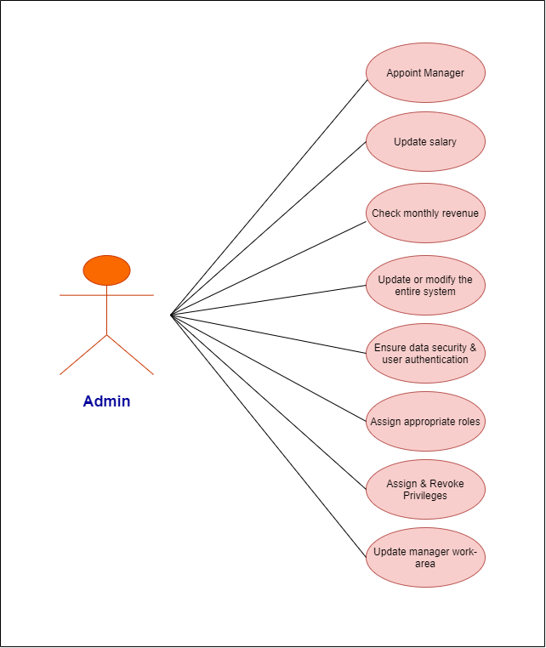
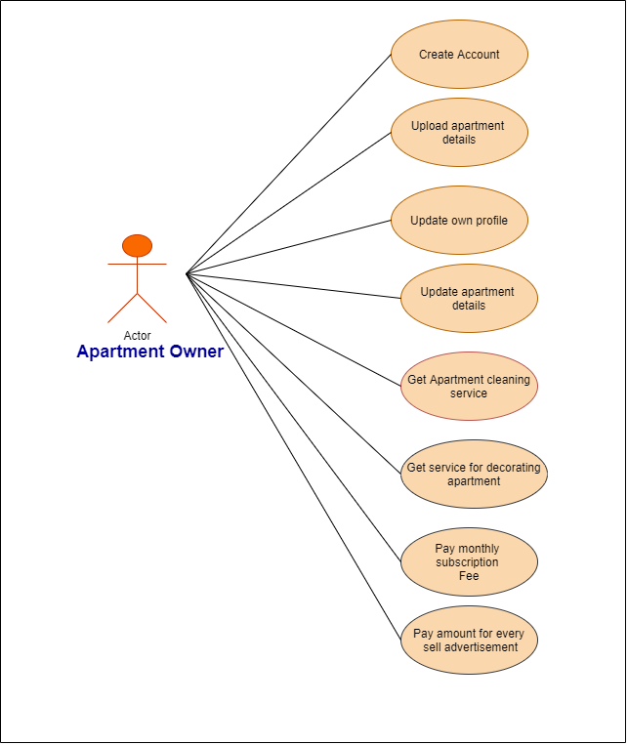
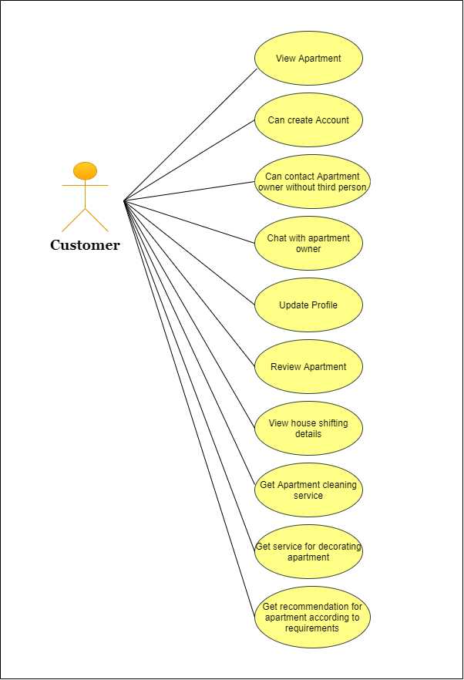
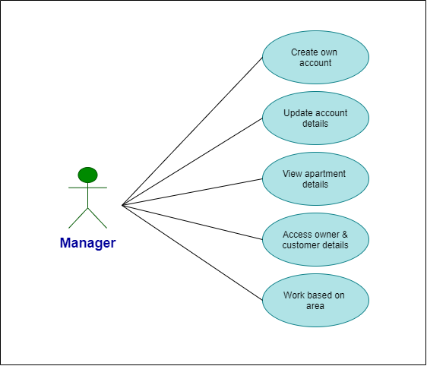
Use case diagram

Slide 13
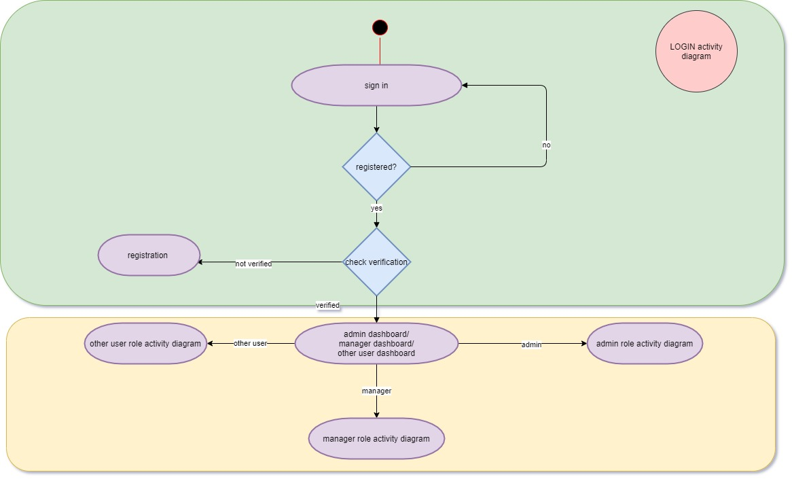
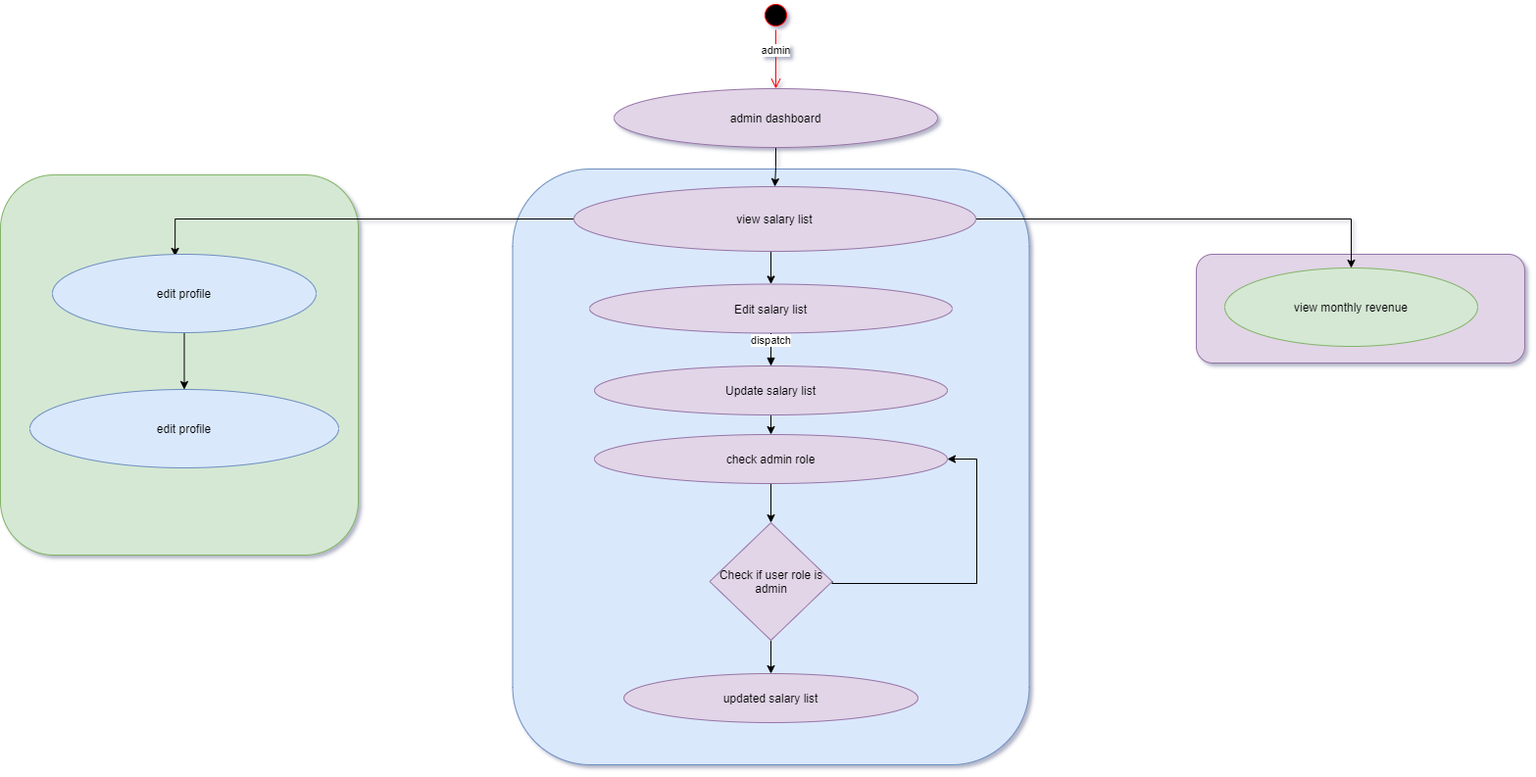
Activity Diagram
Login Activity
Diagram
Admin Activity
Diagram

Slide 14
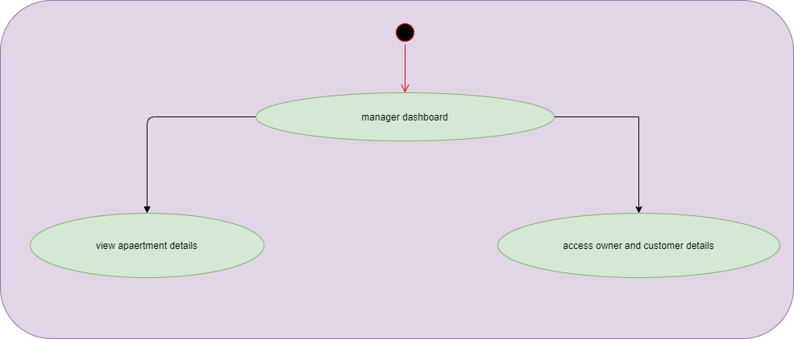
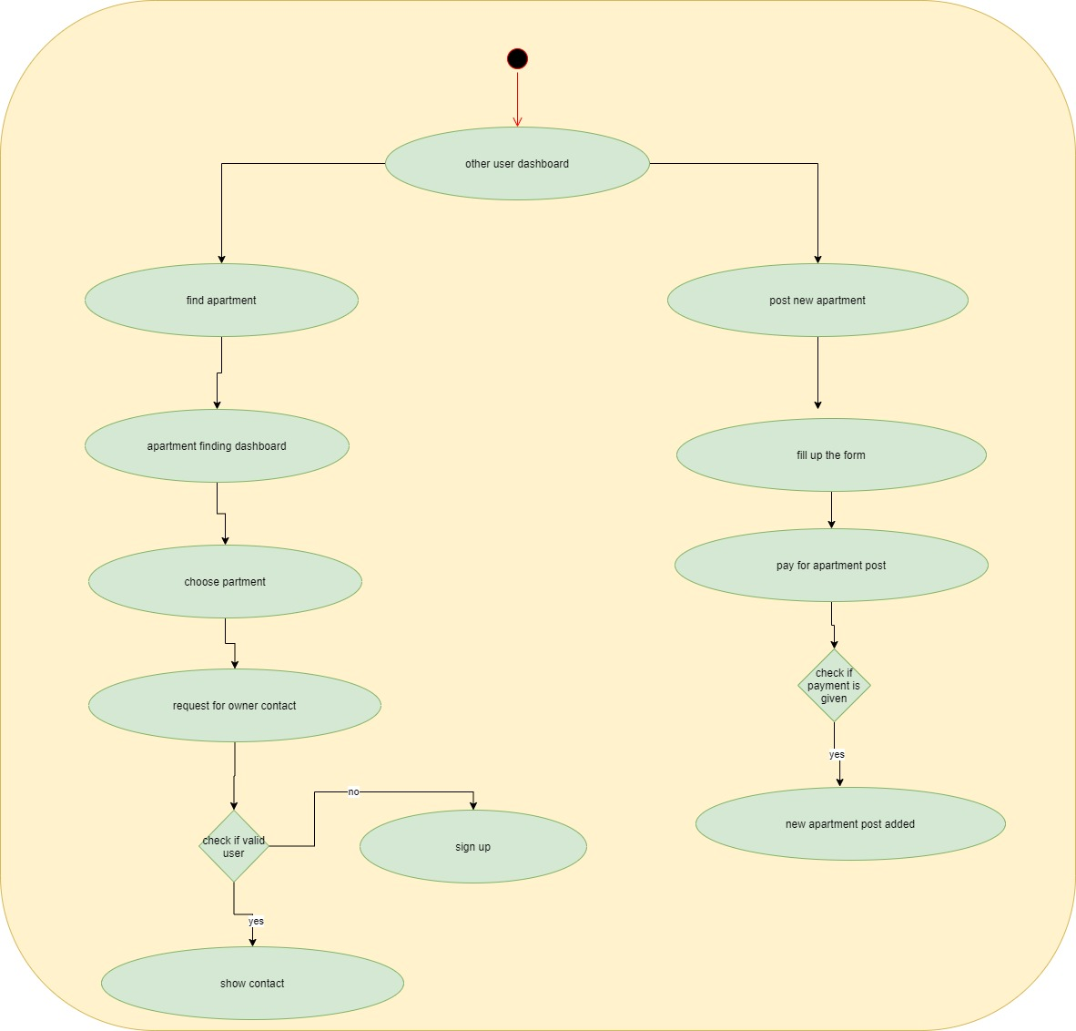
Activity Diagram
Manager Activity
Diagram
User Activity
Diagram

Slide 15
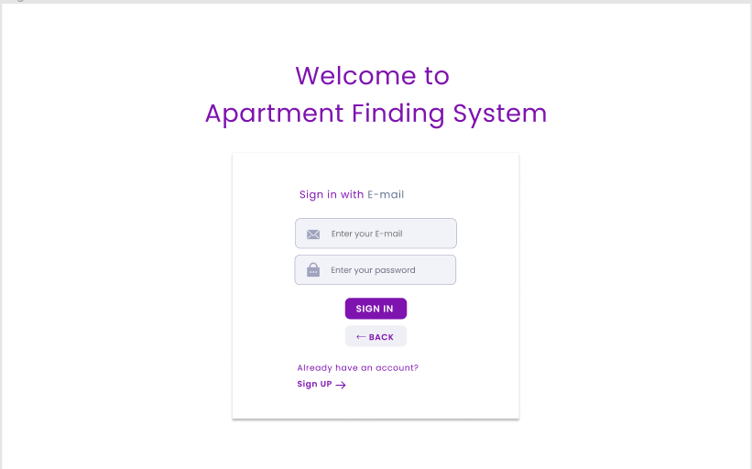
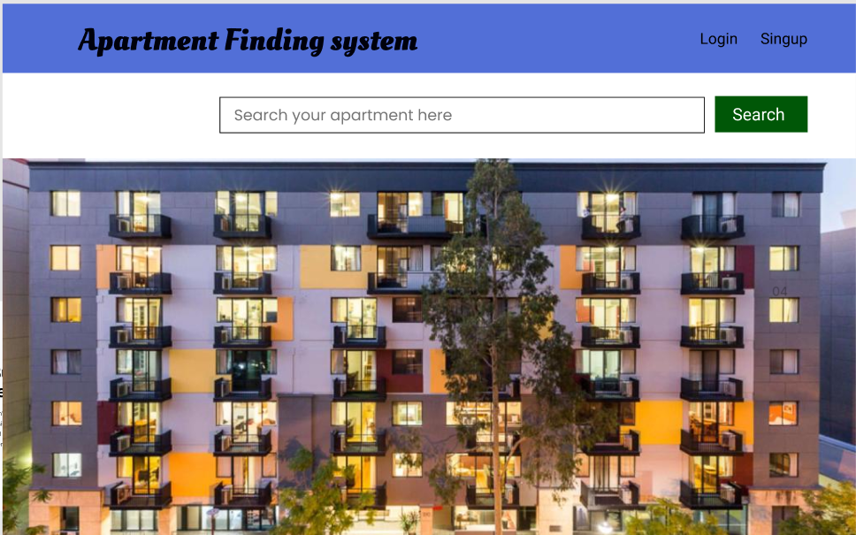
Prototype
Login UI
Homepage

Slide 16
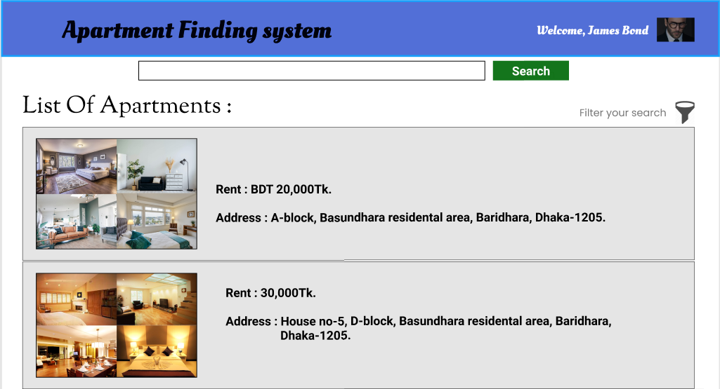
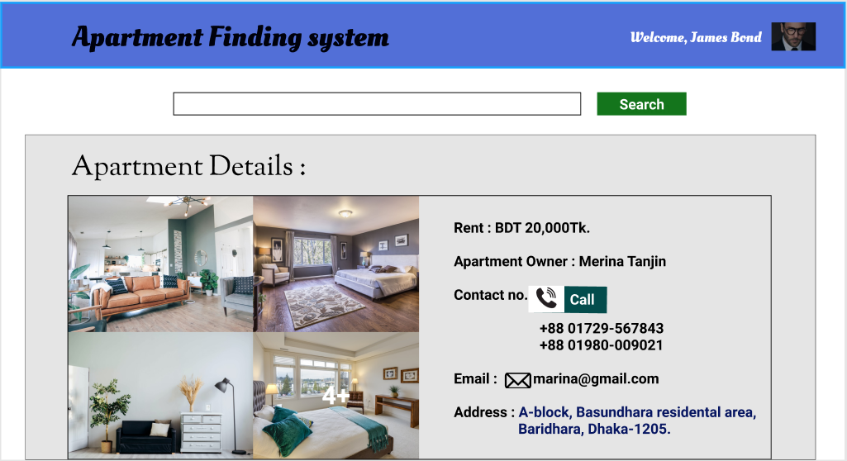
Prototype
Search Apartments
Apartments Details

Slide 17
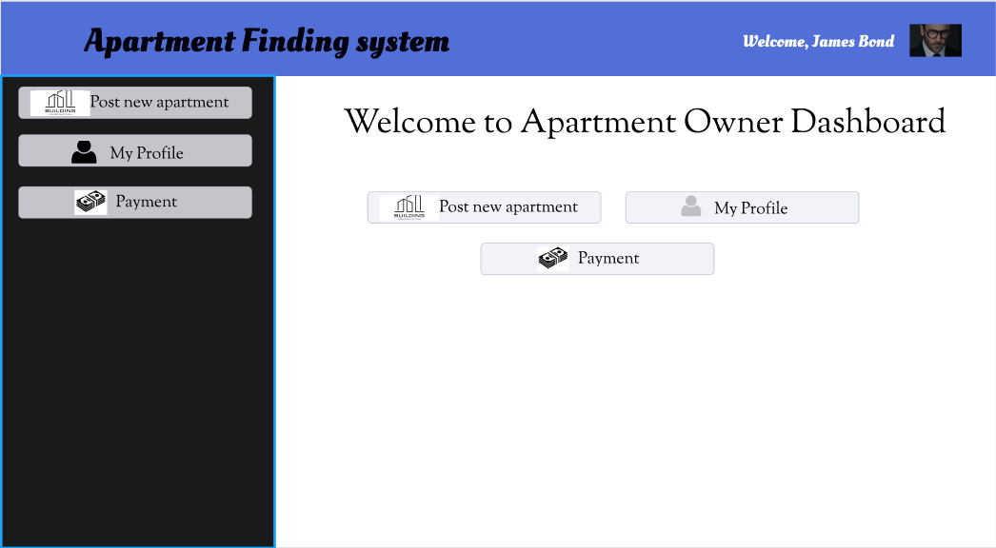
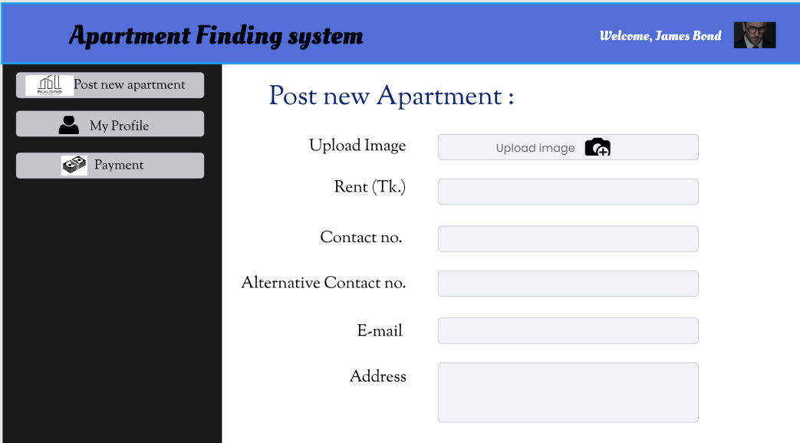
Prototype
Apartment Owner Dashboard
Post New Apartments

Slide 18
Project Planning
Collect all the requirements
Think of our plan as a roadmap for stakeholders
These stakeholders might include:
The project manager, The customer, The team
Break the project into a list of deliverables
Talk to our team
Identify risks
Create a budget
Set progress reporting guidelines

Slide 19
Schedule and budget
Front-end activities (40-50%)
Construction activities (15-20%)
Testing and installation (30-40%)
Total days for development: 138 working days
Total time for development: 8 months

Slide 20
Budget
Items | Daily Cost (BDT) | No. of Days | Total Cost (BDT)
Front-end developer | 650 | 96 | 62,400
Back-end developer | 750 | 88 | 66,000
Business engineering | 400 | 25 | 10,000
Total development cost |  |  | BDT 138,400
Overhead Cost (20%) |  |  | 27,680
Safety net for spillover (8%) |  |  | 11,072
Cloud Server |  |  | 260,000
Net cost |  |  | BDT 437,152

Slide 21
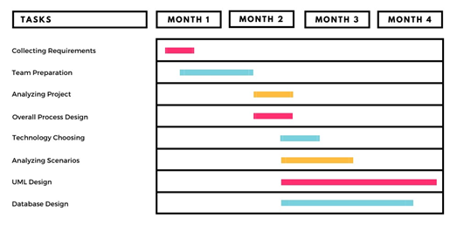
Schedule
Tasks | MONTH 1 | MONTH 2 | MONTH 3 | MONTH 4
Collecting Requirements | 1/8/2021 to 15/8/2021
Team Preparation | 8/8/2021 to | 12/9/2021
Analyzing project |  | 12/9/2021 to 30/9/2021
Overall Process Design |  | 12/9/2021 to 30/9/2021
Technology Choosing |  | 25/9/2021 to | 10/10/2021
Analyzing Scenarios |  | 25/9/2021 to | 25/10/2021
UML Designs |  | 25/9/2021 to |  | 28/11/2021
Database Design |  | 25/9/2021 to |  | 15/11/2021

Slide 22
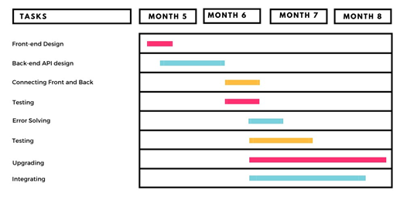
Schedule
Tasks | MONTH 5 | MONTH 6 | MONTH 7 | MONTH 8
Front-end design | 1/12/2021 to 20/12/2021
Back-end and API design | 15/12/2021 to | 15/1/2022
Connecting front and back |  | 10/1/2022 to 30/1/2022
Testing |  | 10/1/2022 to 30/1/2022
Error solving |  | 15/1/2022 to | 10/2/2022
Testing |  | 15/1/2022 to | 20/2/2022
Upgrading |  | 15/1/2022 to |  | 30/3/2022
Integrating |  | 15/1/2022 to |  | 22/3/2022

Slide 23
Risk Management
Some common risks are:
• Inaccuracies in the time and resource estimations.
• Scalability of the core framework architecture.
• Sudden change of requirements.
• Government rule changes.
• More focus on technical complexity, rather than user experience.

Slide 24
Risk management plan
Risks | Probability | Rating
Project Manager Availability | 50% | Medium
Schedule slips | 70% | High
System goes hour | 60% | Medium
Project canceled | 30% | Low
False feature rich | 40% | Low
Programmers doesn’t have good experience | 50% | Medium
Late delivery | 50% | Medium
Customer Participation in Beta Testing | 30% | Low

Slide 25
Conclusion
This apartment management system has been developed based upon the studying common scenario and web applications of similar kind. In this document we tried to provide solutions for the problems we came across in similar existing websites. If the budget and timeframe can accommodate more features then there will be changes in this document and development process.

Slide 26
references
M. Nosworthy, G. Blanchard, R. Tripad, “bproperty,” 2015, https://www.bproperty.com/
C. Capital, F. Partners, “perforce.com”, 2014, https://www.perforce.com/blog/alm/how-write-software-requirements-specification-srs-document
J. graph, “appdiagram.com”, 2005, https://app.diagrams.net/
D. Field, “UI design”, 2016, https://www.figma.com/files/recent?fuid=1001531349736242039
Wikipedia, “software development", last edited 30 July, 2021, https://en.wikipedia.org/wiki/Software_development
M. Mohtashim, “tutorialspoint”, 2006, https://www.tutorialspoint.com/software_engineering/software_project_management.htm
M. Mohtashim, “tutorialspoint”, 2006, https://www.tutorialspoint.com/software_engineering/software_requirements.htm
B. Smith, “landing,” 2019, https://www.hellolanding.com/blog/apartment-hunting-tips/
A. Stringer, C. Stringer, “Molly maid”, 1979, https://www.mollymaid.com/our-services/apartment-cleaning/
A. I. Halim, “sheba.xyz”, 2015, https://www.sheba.xyz/house-shifting-service
S. Jain, “geeksforgeeks”, 2008, https://www.geeksforgeeks.org/software-engineering-software-quality-assurance/
Wrangler Topco. LLC, “time management”, 2006, https://www.wrike.com/project-management-guide/faq/what-is-time-management-in-project-management/

Slide 27
THANK YOU

